Slide 1
Add a heading
Add a subheading

Slide 2
What is UNIC?
UNIC is the European University of Cities in Post-Industrial Transition.
We are an alliance of ten universities based in post-industrial cities with a mission to boost mobility and inclusion for societal impact.
Together, we educate through teaching, research and community engagement, towards inclusive societies.

Slide 4
What UNIC Offers
One European university connecting 10 unique universities and their vibrant post-industrial cities
UNIC is building the University of the Future: a model for how to bring together learning, engaged research and innovation.
UNIC is a true partnership of students, teachers, and citizens.

Slide 5
UNIC Initiatives
CENTRE FOR
TEACHING AND LEARNING
“One-stop-shop” for universities to engage with cities + communities for transformative innovation
State-of-the-art Blended Intensive Programs, virtual and physical mobility, and joint degrees
Innovating in intercultural teaching, challenge-based learning, and sustainability education

Slide 6
Testimonial
“
Quote
Quote
Quote
Quote
”
Name
Position
Photo Credit

Slide 7
Testimonial - Student
“
UNIC is a big improvement for our European society. It gives current students the opportunity to leave a better future behind for future generations.
”
Rabia Demirelli
Student, Ruhr University Bochum
Photo Credit: UNIC

Slide 8
Testimonial - Research
“
UNIC collaborations broadened my horizons for knowledge, and the effects were multi-fold. I learned even more than I expected!
”
Lucija Kanjer
Doctoral Researcher, University of Zagreb
Photo Credit: University of Zagreb

Slide 9
Testimonial - Staff
“
Our UNIC staff exchange was an amazing opportunity to deepen our own work, learning through our big differences and being inspired by our shared dreams.
”
Linda de Vreede and Denise Levy
Impact at the Core, EUR
Photo Credit: Linda de Vreede

Slide 10
#EuropeanUniversity
UNIC is one of over 50 European Universities Alliances, part of an ambitious and flagship EU initiative.
Through long-term structural and sustainable cooperation, alliances like UNIC will improve the international competitiveness of higher education institutions in Europe, and promote European values and identity
Photo via Erasmus+

Slide 11
Heading
Text
Photo Credit

Slide 12
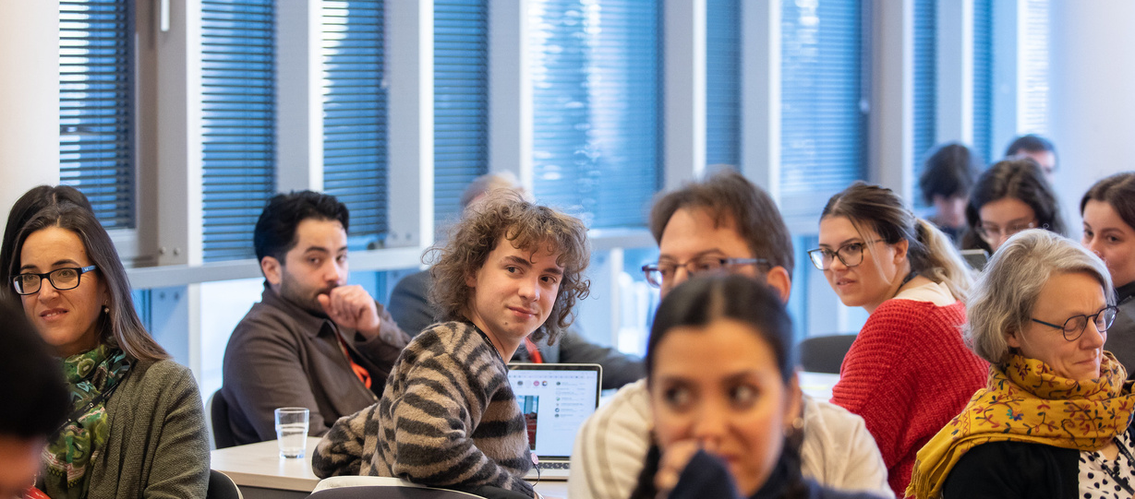
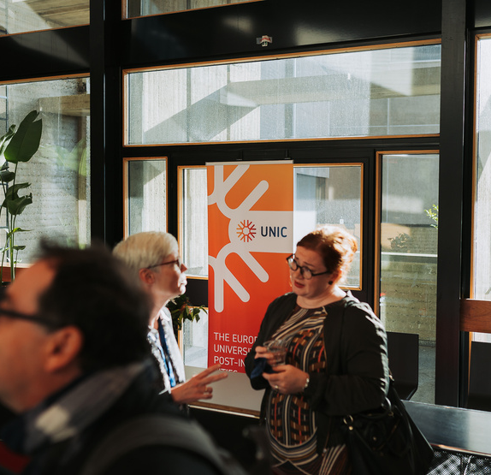
Heading
Text
Photo Credits

Slide 13
Stay in Touch
UNIC (European University of Cities in Post-Industrial Transition)
newsletter sign-up
QR code here
@unic_eu
European University of Post-Industrial Cities
@unic_eu
+ contact us via email: info@unic.eu

